Slide 1
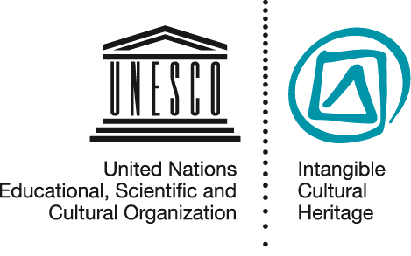
Community participation in safeguarding
RAT PPT 2.6
UNESCO
Intangible Cultural Heritage Section

Slide 2
In this presentation ...
Why community participation
Defining communities
Roles of stakeholders
Examples
Photo of community meeting (pref Africa)

Slide 3
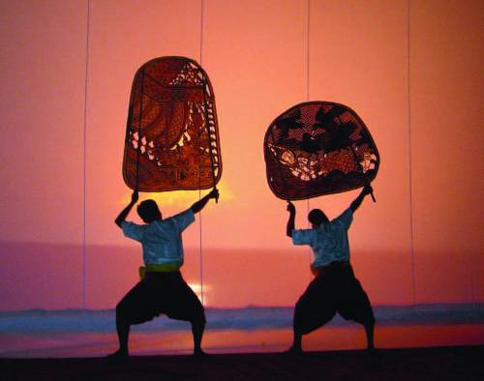
Reasons for community participation
People enact ICH, and identify with it;
ICH belongs to their heritage;
Safeguarding means continued practice and transmission by them;
Safeguarding requires their participation and consent
Sbek Thom shadow theatre © National Museum of Cambodia

Slide 4
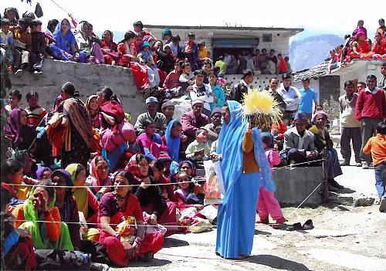
Defining the community concerned
Under the Convention, ‘communities, groups and individuals concerned’ means those who participate in the practice or transmission of specific ICH elements, and consider them to be part of their cultural heritage
Ramman: religious festival and ritual theatre of the Garhwal Himalayas, India © IGNCA, Ministry of Culture

Slide 5
The role of communities
Identification
Inventorying
Documentation
Research
Revitalization
Ensuring sustainability
Ensuring access to places and materials
Transmission through education
Transmission
Enactment
Communities
Groups
Awareness-raising
Other agencies

Slide 6
Opinion: Dr Londres Fonseca
“In my own opinion, what is really needed is for the community to participate in the process [of inventorying]... If the inscription [on an inventory] takes place without dialogue with the community ... I wonder whether there will actually be any [community] involvement in safeguarding.”
Notes:
Fonseca interview clip: “In my own opinion, what is really needed is for the community to participate in the process [of inventorying], because otherwise our vision is going to be too remote from what is actually happening and we shall fail to realize that the name and category of the element are not the only thing that matters. What matters above all are its meanings, the values attributed to it and how people practise it, which varies a lot. These are older people, and, of course, an anthropologist’s view helps a lot, but I doubt whether the anthropologist’s view is enough. No doubt an anthropologist is very helpful and knows the methodology, but the problem is not just description, because for us an inventory is the first step towards safeguarding. If the population takes part in the inventory, if the community is involved, it has already become a partner in this process. If the inscription takes place without dialogue with the community, even if there is a formal gesture in this direction, I wonder whether there will actually be any involvement in safeguarding or whether this involvement will have to be built afterwards. This is not impossible, but I think it is better to do it beforehand if possible. However, I realize that scale is something very complicated here, and I think that each country must find its own answers.”

Slide 7
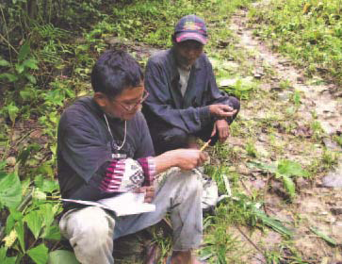
Example: Subanen community documentation
Elders recognized that their knowledge about local plants was not being passed on to younger community members
They asked for help to train young people to document this knowledge within the community
Copyright protection gained
Materials included in the school curriculum
A Subanen member of the
documentation team receiving
information from an older member
of the community.

Slide 8
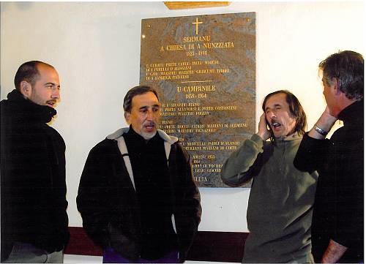
Example: community participation in safeguarding
Cantu in Paghjella: Polyphonic singing (Corsica/France)
Expert-practitioner meetings
Formation of a practitioner association
Media campaigns
© Michèle Guelfucci-Glinatsis, 2009

Slide 9
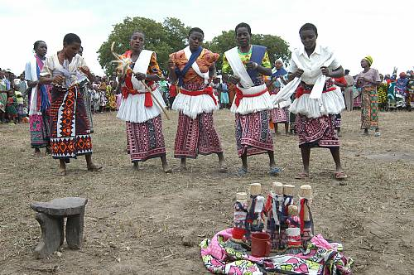
Example: community participation in safeguarding
Traditions and practices associated with the Kayas of the Mijikenda (Kenya)
Community consultations
Incorporating community ideas into the safeguarding plan
Community development groups formed
© 2007 by National Museums of Kenya

